Slide 1
Bayesian Inference and the MNIST Dataset
Contributors: Jason Spaw

Slide 2
Objectives:
Discuss technology
Show model performance to stakeholders
Model Selection
Discuss use cases

Slide 3
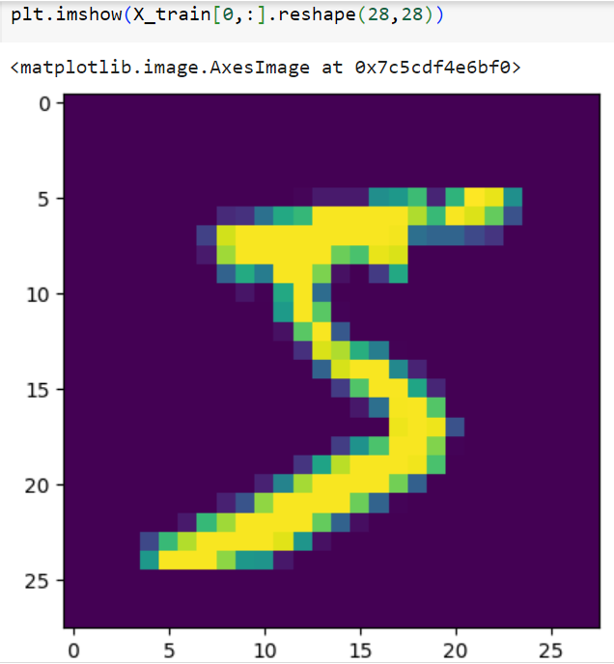
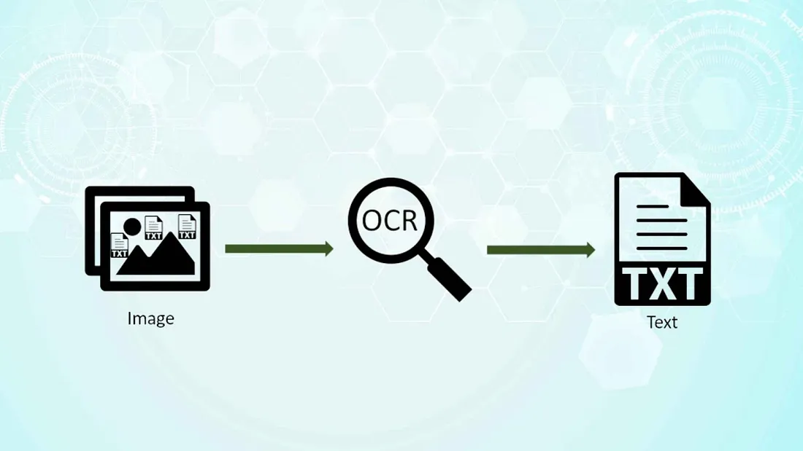
Technologies
Optical Character Recognition (OCR)
Models: Naive Bayes, Gaussian Naive Bayes, Gaussian Bayes, and K-Nearest Neighbors (KNN) Classifiers

Slide 4
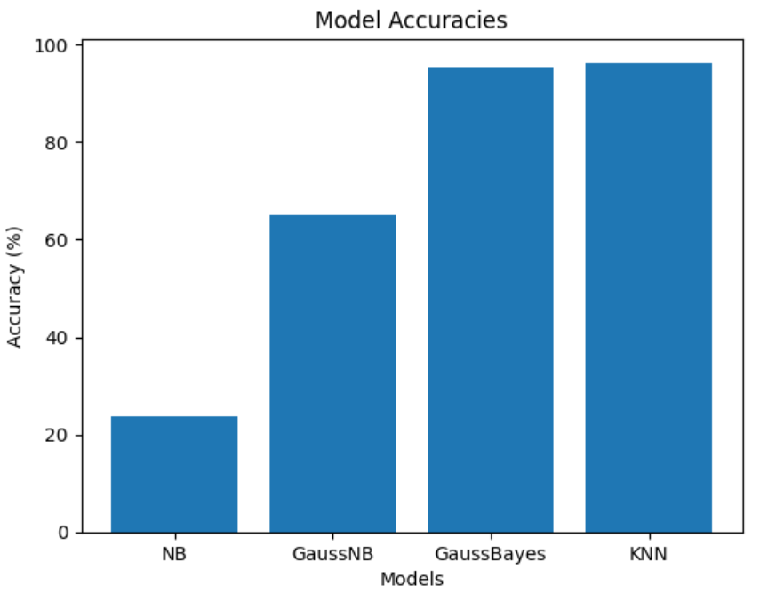
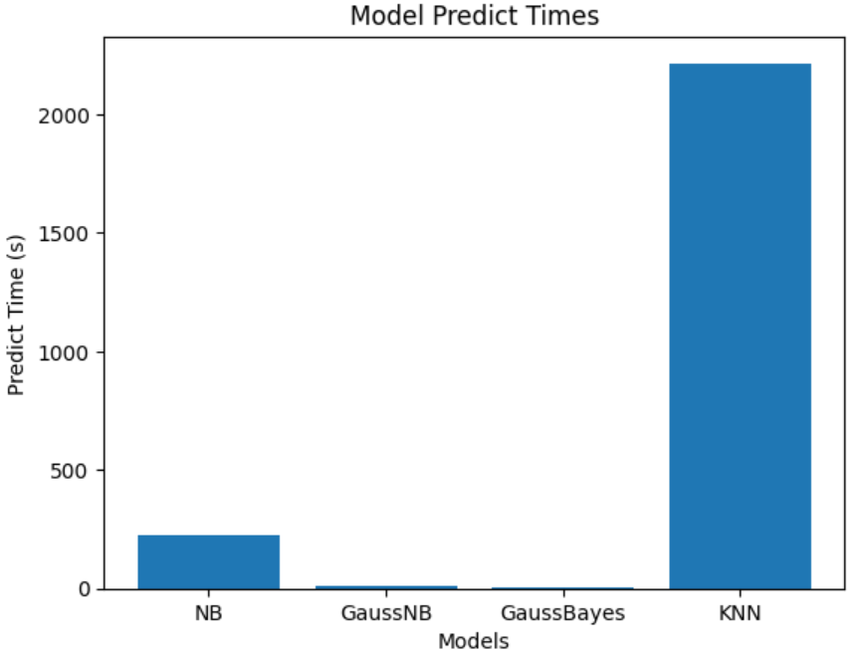
Model Performance
95.4%
96.3%
2215.1 sec
(37 min)
6.4 sec

Slide 5
Model Selection
Best fit: Gaussian Bayes
High Accuracy (95.4%)
Low Predict Time (6.4 sec)

Slide 6
Use Cases
Document Scraper
Scrape information from documents during scanning process and pipeline to digital forms and documents
Web Scraper
Scrape non text web information,including images containing text, such as memes
Sentiment Analysis (Financial, Political, Product Reviews, etc.)
Digital Notepad Application
Automatically, translate handwritten text to digital text
Faster note taking for employees who lack typing skills in the field

Slide 7
Conclusion
Goal: Optical Character Recognition (OCR)
Models: Naive Bayes, Gaussian Naive Bayes, Gaussian Bayes, and K-Nearest Neighbors (KNN) Classifiers
Best fit: Gaussian Bayes
High Accuracy (95.4%)
Low Predict Time (6.4 sec)
Use Cases:
Document Scraper
Web Scraper
Digital Notepad Application

